Slide 1
Project Mini Updates
Yonathan & Maanas
T2: NBA Stats

Slide 2
Mini Update #1 - Data Profile (Fixed)
Dataset: 217 rows, 30 columns. All 30 columns listed below (grouped by type). No missing values.
Column(s) | Missing? | Data Type | Useful? | Need Cleaning?
Player, Pos, Tm, Age | No | Categorical/Text | Yes - identifies each player, their position, team, and age | Pos may need filtering (TOT = multi-team duplicate rows)
G, GS, MP | No | Numeric | Yes - games played, games started, total minutes needed for per-minute analysis | No
FG, FGA, FG%, 2P, 2PA, 2P%, eFG% | No | Numeric | Yes - overall and 2 pt field goal volume and efficiency | No
3P, 3PA, 3P%, FT, FTA, FT% | No | Numeric | Yes - 3 point and free throw shooting volume and efficiency | No
ORB, DRB, TRB | No | Numeric | Yes - offensive, defensive, and total rebounds per player | No
AST, STL, BLK, TOV, PF, PTS | No | Numeric | Yes - key stats, PTS is the primary outcome variable for our analysis | No

Slide 3
Which players score the most points in the 2022-2023 playoffs?
Does more playing time (MP) lead to higher scoring (PTS)?
Which position (PG, SG, SF, PF, C) performs best overall?
Do higher shooting percentages (FG%, 3P%) lead to more points scored?
Which players contribute most across rebounds, assists, and points combined?
Audience:
Basketball fans, fantasy players, and sports analysts
Classmates and instructor
Mini Update 1 Curious Questions

Slide 4
Mini Update #1 Audience/Communication Goals:
Identify key performance patterns and trends in the 2022-2023 NBA playoffs
Compare player performance across positions using clear visualizations
Show that top players contribute beyond just scoring, and highlighting well rounded performance
Give audience insight into niche stats they may not typically consider (for example, eFG%, ORB rate)

Slide 5
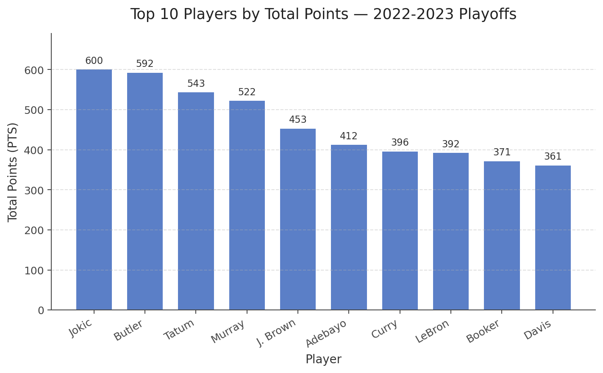
Insight 1: Who Were the Top Scorers? (Maanas)
● Nikola Jokic led the 2022-2023 playoffs with 600 total points, closely followed by Jimmy Butler (592).
● A small group of elite players dominates the top 4 all scored 500+ while #10 Anthony Davis had 361.
● Guards and forwards appear most often, reflecting their higher usage scoring roles.
● This supports the idea of star concentration,a few players carry most of their team's offensive load deep in the playoffs.

Slide 6
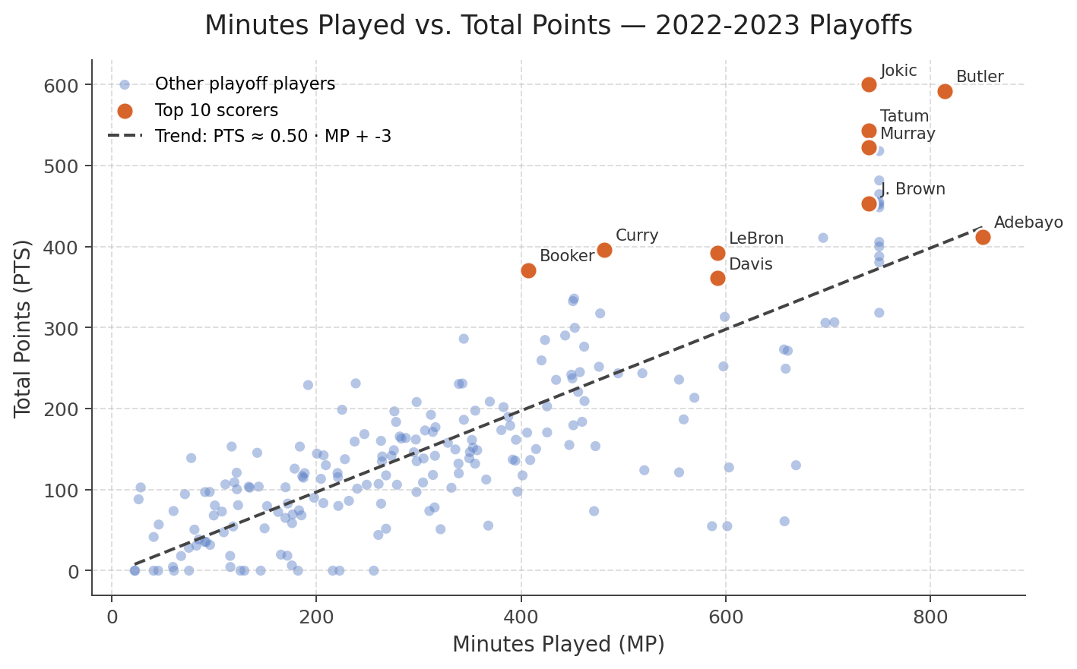
Insight 2: Does More Playing Time Mean More Points? (Maanas)
● There is a clear positive relationship between minutes played and total points scored (slope is around 0.5 PTS per MP).
● Stars like Curry and Booker sit well above the trend they played fewer games but scored very efficiently.
● Some high MP players fall below the line (for example, Adebayo), suggesting role differences like defense and playmaking.
● Minutes alone don't explain scoring usage rate and role also matter.

Slide 7
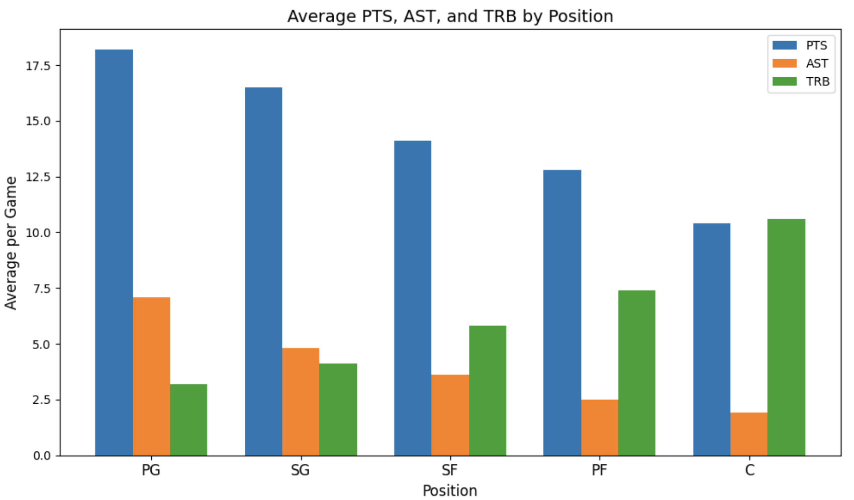
Insight 4: Which Position Scores and Contributes Most? (Yonathan)
Guards (PG, SG) lead in scoring and assists on average, consistent with their ball-handling roles
Centers (C) dominate in rebounds, reflecting their positioning near the basket
No single position dominates all three stats and each position has a distinct contribution profile

Slide 8
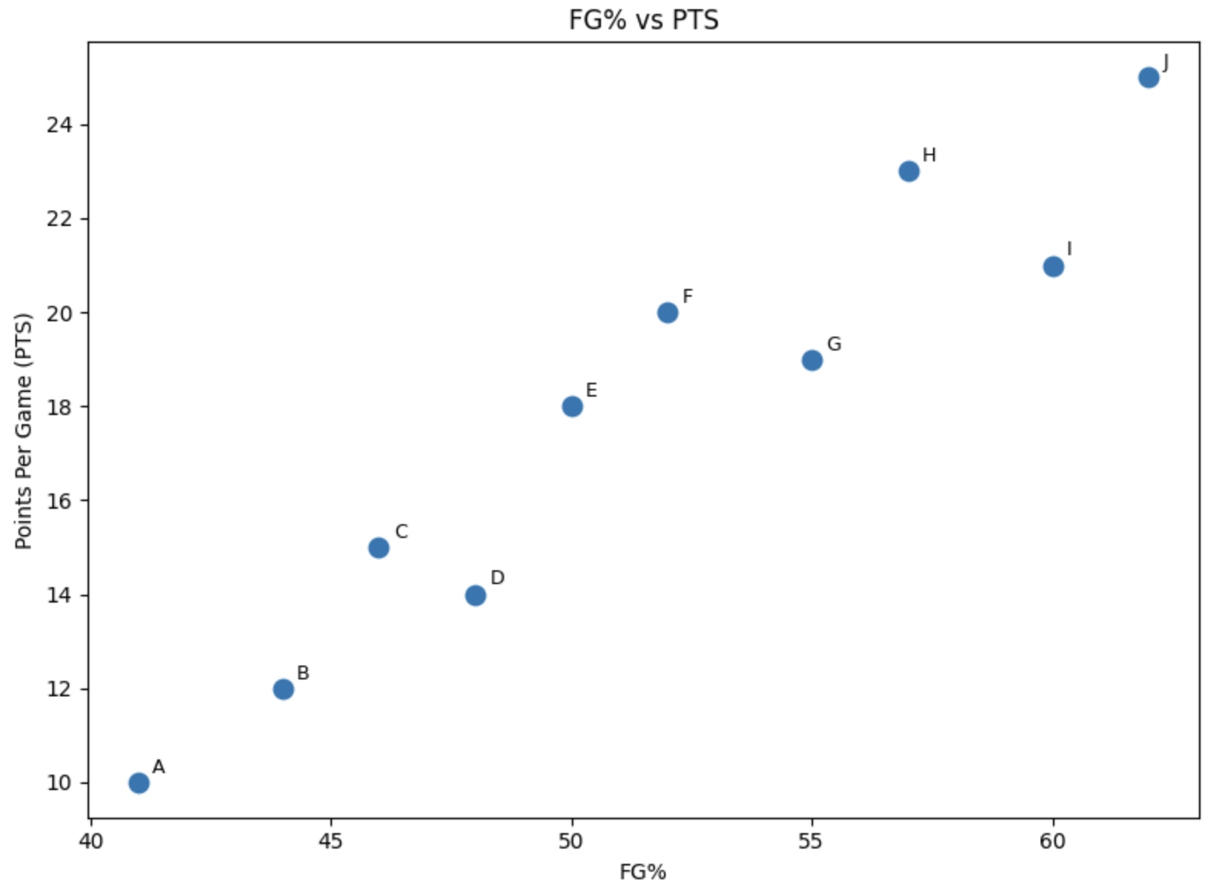
Insight 5: Does Shooting Efficiency Drive Scoring? (Yonathan)
Higher FG% does not always mean more points, sometimes high volume shooters can outscore efficient low volume ones
Top scorers tend to combine high FGA with above average FG%, showing true elite two-way ability
Shot volume (FGA) is a stronger predictor of total points than shooting efficiency alone

Slide 9
Mini Update #2
T2: NBA Stats | Yonathan & Maanas

Slide 10
Project Progress Check for Update 2 (Maanas)
WHAT I WORKED ON THIS WEEK
OBSTACLES
● Started building my bar chart of the top 10 playoff scorers by total PTS
● Began working on the MP vs PTS scatter plot to see if more minutes means more points
● Helped clean up TOT rows so players who switched teams mid season aren't double counted
The duplicate TOT rows were the biggest issue. Players who were traded mid season appear multiple times in the dataset, so I had to figure out how to filter them out without losing real data.
RESOURCES USED
JupyterHub Python Notebook
VScode was also used due to familiarity with it.

Slide 11
Response to Feedback from Mini Update #1 (Maanas)
FEEDBACK FROM DR. CHEN
HOW WE ADDRESSED IT
N/A
N/A

Slide 12
PROJECT PROGRESS CHECK FOR UPDATE 2 (YONATHAN)
WHAT I WORKED ON THIS WEEK
● Started working on a line graph to show how scoring trends change over different playoff years ● Began analyzing the relationship between FG% and total points to see if efficiency impacts scoring ● Helped organize the dataset by removing unnecessary columns and focusing only on key stats like PTS, MP, and FG%
OBSTACLES
Understanding which stats were actually useful was a challenge at first. The dataset had a lot of extra columns, so it took time to figure out what to keep and what to remove without losing important information.
RESOURCES USED
JupyterHub Python Notebook
Also used online Python documentation and class notes to better understand how to clean and organize the data

Slide 13
Mini Update #3
T2: NBA Stats | Yonathan & Maanas

Slide 14
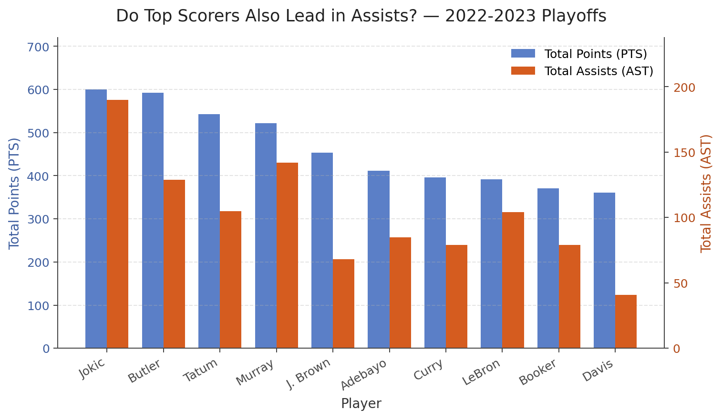
Insight 3: Do Top Scorers Also Lead in Assists? (Maanas)
● Jokic combines elite scoring (600 PTS) with elite playmaking (190 AST) a true all around MVP.
● Jamal Murray and LeBron also pair high scoring with high assists, showing well rounded production.
● Pure scorers like J. Brown, Booker, and Davis show a big PTS and AST gap they create points but don't create for others as much.
● This answers our Mini Update #1 curious question: top scoring DOES often come with high assists, but not always it depends on the player's role.

Slide 15
Project Progress Check for Update 3 (Maanas)
WHAT I WORKED ON THIS WEEK
OBSTACLES
● Finalized the top 10 scorers bar chart and wrote the takeaway about star concentration
● Cleaned up the MP vs PTS scatter plot and noticed the role-based outliers
● Added a third insight comparing PTS and AST for the top 10 scorers to answer the curious question about well rounded players
● Synced with Yonathan so my Insights 1, 2, and 3 flow with his Insights 4 and 5
On the scatter plot, the dots overlapped a lot near the lower left corner, which made the overall trend harder to read. I had to decide whether to keep every player or filter by a minimum minutes threshold.
NEXT STEPS
Begin storyboarding (Mini Update #5) — pick the strongest two or three charts to anchor the final data story.

Slide 16
Response to Feedback from Mini Update #2 (Maanas)
FEEDBACK FROM DR. CHEN
HOW I ADDRESSED IT
N/A
N/A

Slide 17
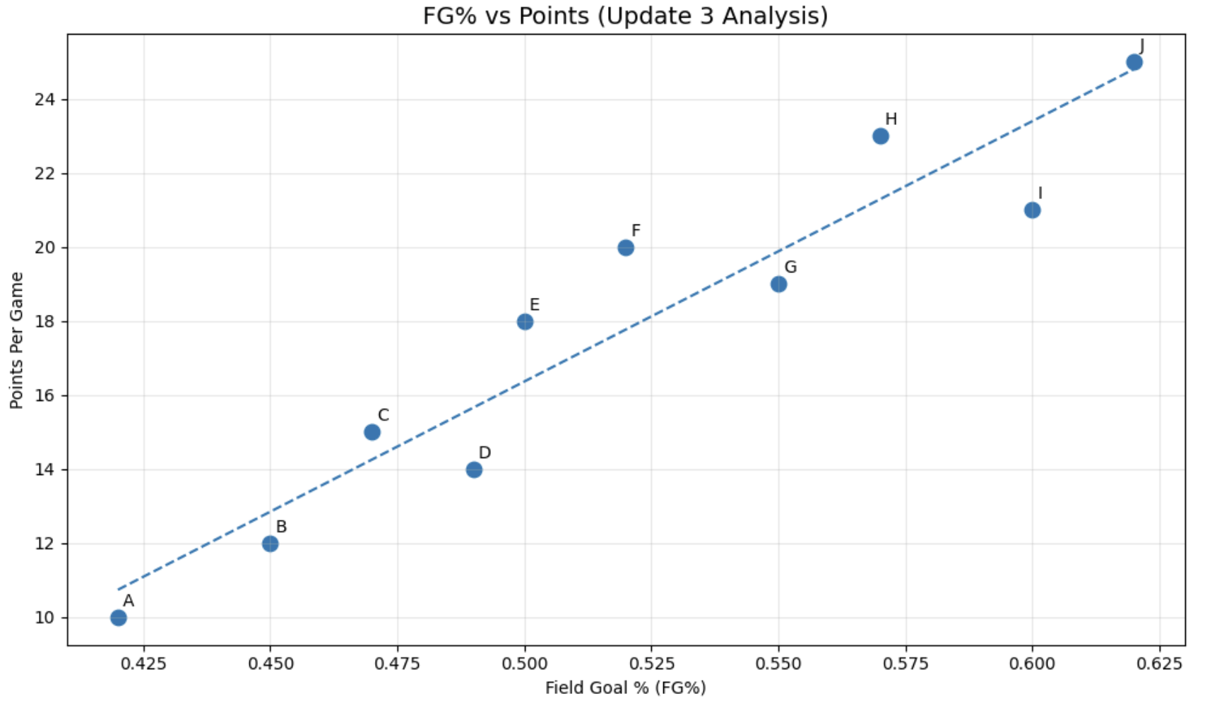
How strong is the FG% to Scoring Relationship (YONATHAN)
There is a clear positive relationship between FG% and points scored, meaning more efficient players tend to score more.
However, the relationship is not perfectly linear, as players with similar FG% can have different scoring outputs.
This suggests that shot volume and player role play a major role alongside efficiency.
Some high-scoring players combine both high FG% and high shot attempts, making them the most impactful offensively.
Overall, FG% contributes to scoring, but it is not the only driver — volume and usage must also be considered.

Slide 18
Project Progress Check for Update 3 (YONATHAN)
How strong is the FG% to Scoring Relationship
Obstacles
What i worked on this week
In the FG% vs scoring analysis, the relationship was not perfectly clear since some players with high efficiency did not score as much, making the trend harder to interpret. It was also difficult to separate the impact of shooting efficiency from shot volume and player roles.
There is a clear positive relationship between FG% and points per game.
Players with better shooting efficiency generally score more, but the relationship is not perfect.
Some players score less efficiently, which suggests shot volume and role also matter.
This supports our earlier finding that efficiency helps scoring, but it is not the only driver.
Next steps
Build on the FG% vs scoring analysis by adding variables like shot attempts (FGA) or True Shooting % to better explain how efficiency and volume together impact scoring.

